Slide 1

Helps for kittens
Syntax error
© 2022 Комп'ютерна школа Hillel

Slide 2
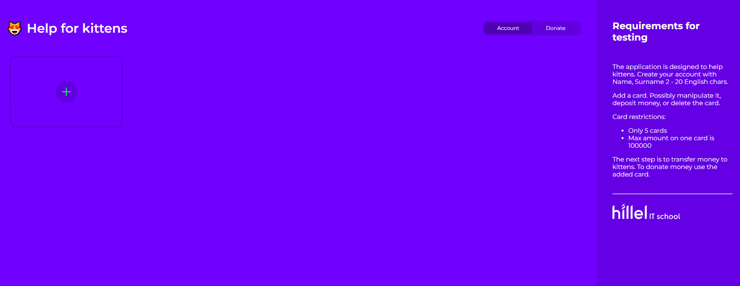
Main purpose:
The application is designed to help kittens. User can create 5 cards, deposits money up to 100000, and donate any sum to kittens. When the user opens the application, he will card section, two tabs Account, Donate and basic requirements.
Account - this section helps to add and manipulate cards
Donate - this is payment section where user can send money to kittens
Incorrect interpretation
Maybe there is should be a button “Add a card”?
© 2022 Комп'ютерна школа Hillel

Slide 3
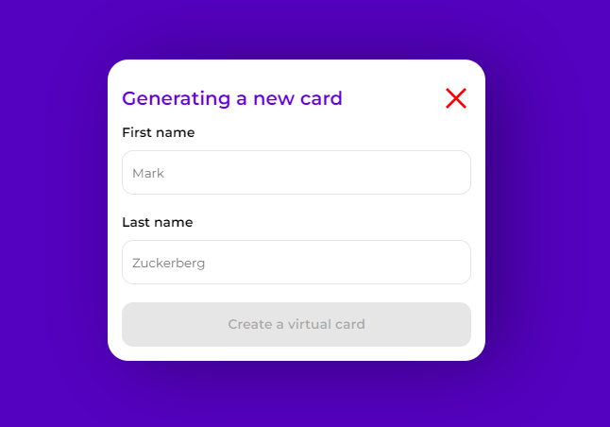
When user adds new card, shows pop up
Generating a new card
First/Last name - only English letters 2 - 20 chars. If user tries to set other data, field functionality has to block this data.
Button Create a virtual card disabled
User can add only 5 cards.
Should the button “Create a virtual card?” become enable after entering correct data?
© 2022 Комп'ютерна школа Hillel

Slide 4
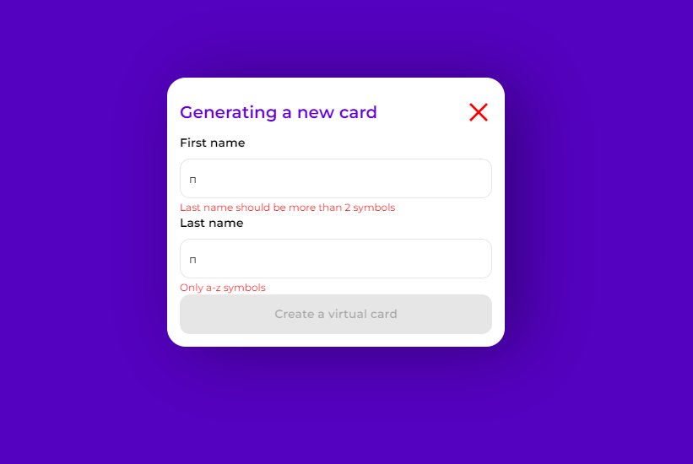
Errors:
First/Last name should be more than 2 symbols
First/Last name should be less than 20 symbols
First/Last name required
Only a-z symbols
2222222
In the field “First name” generates the wrong error, which doesn’t consistence with field data. So it would be necessary to check the consistency of errors and entered data.
© 2022 Комп'ютерна школа Hillel

Slide 5
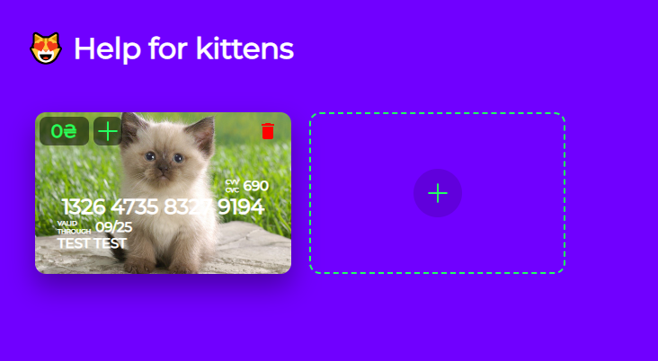
Card view after adding:
Amount - 0 by default
Button + - card replenishment.
Button delete
Card number - 16 random numbers. User have to copy card number just if click on them.
CVV - 3 random numbers
First and Last name
Expiry date - random month in the 2025 year
22222 How will the user understand this?
2222222 at one moment no one will be able to make a payment.
What about a card cover? (Nothing is described here about pictures of kittens)
© 2022 Комп'ютерна школа Hillel

Slide 6
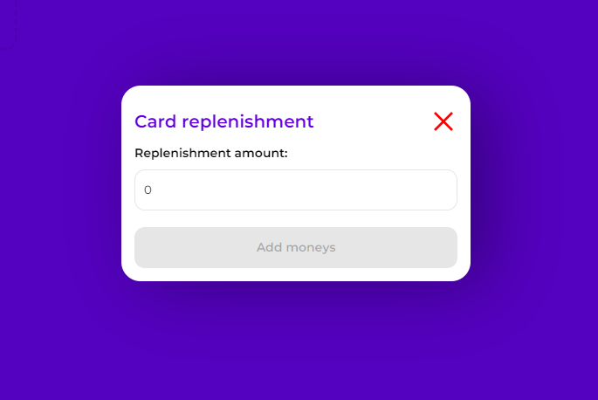
Is that max amount for one payment , or it doesn’t match with previous requirements about max amount 100000?
Card replenishment
Text - Replenishment amount:
Filed - max amount 10000
Button Add moneys - disabled by default
222222222222
It doesn’t matches with field on screen
Should the button “Add moneys” become enable after entering data?
Syntax error. “Add money” - this is a correct form
© 2022 Комп'ютерна школа Hillel

Slide 7
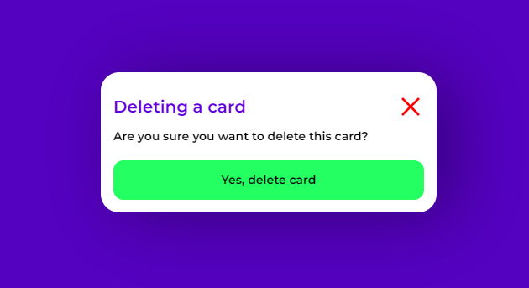
Deleting a card
Text - Are you sure you want to delete this card ?
Button Yes, delete card
If not, user should close the pop up?
2222222222222
Maybe it would be better if developer would add a “No” button.
© 2022 Комп'ютерна школа Hillel

Slide 8
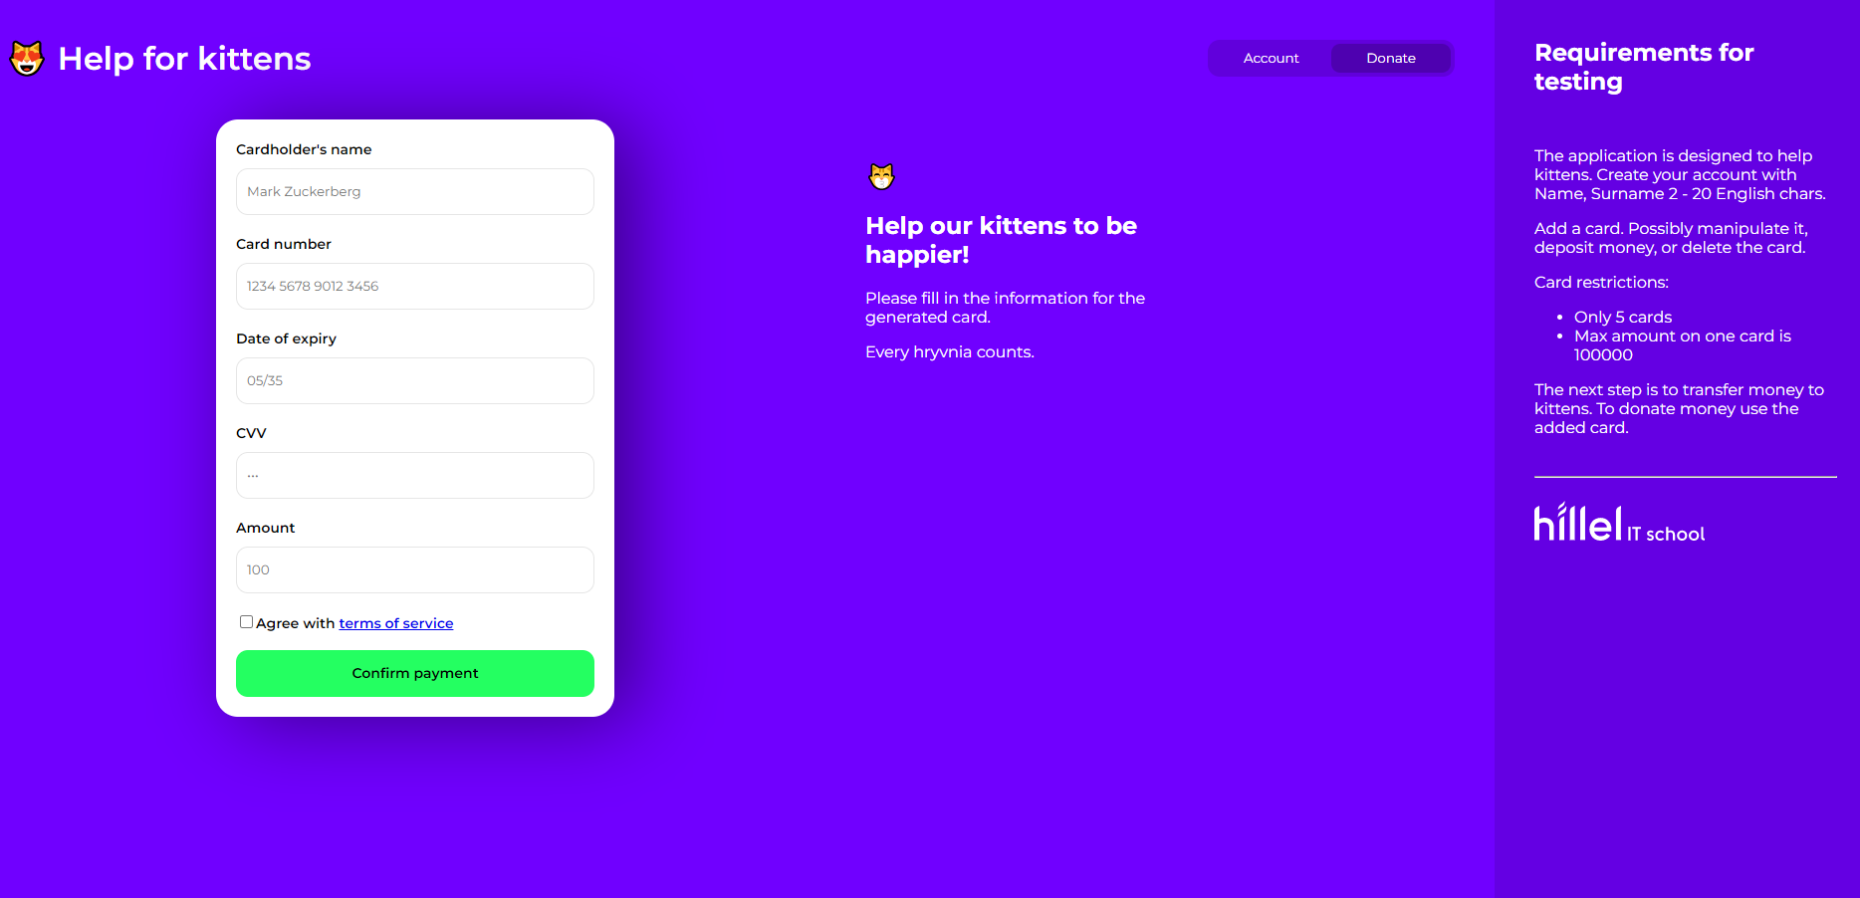
Donate tab
Wrong expiry date.It should be a random month in the 2025 year according to requirements.
© 2022 Комп'ютерна школа Hillel

Slide 9
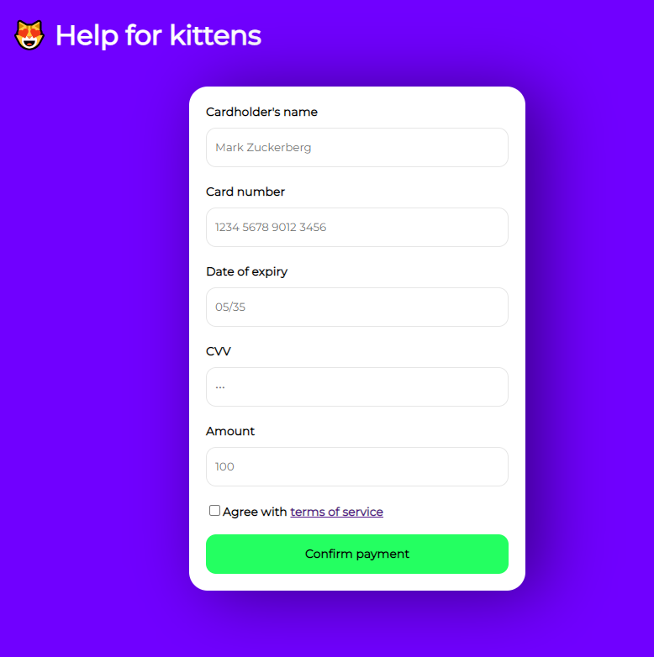
All fields are mandatory, to make donate all data has to match with card data.
Fields:
Cardholder’s name - has to be the same as on credit card
Card number - has to be the same as on credit card
Date of expiry - has to be the same as on credit card
CVV - has to be the same as on credit card
Amount - Max donate amount is 50000.
Link - Agree with terms of service
Button:
Confirm payment - disabled.
There is no button to close pop up/ How a user can close a pop up?
Isn’t there is should be a two different fields for name and surname?
Does the user have to accept the terms of service and tick the box for confirm payment?
Can the user read the terms of service when clicking on the link?
The button enable on the screen.
© 2022 Комп'ютерна школа Hillel

Slide 10
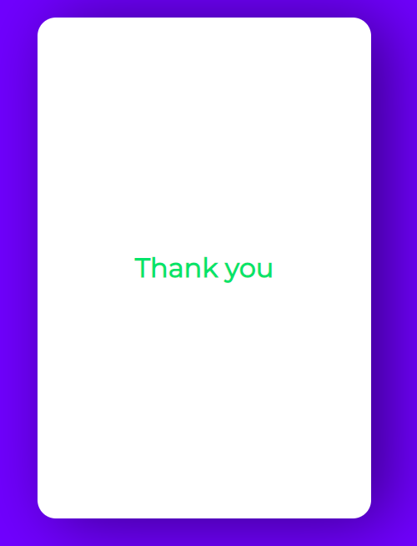
Thank you pop up
There is no description .
222222222222
Under what condition does this pop up appear?
There is no button to close pop up/ How a user can close a pop up?
© 2022 Комп'ютерна школа Hillel

Slide 11
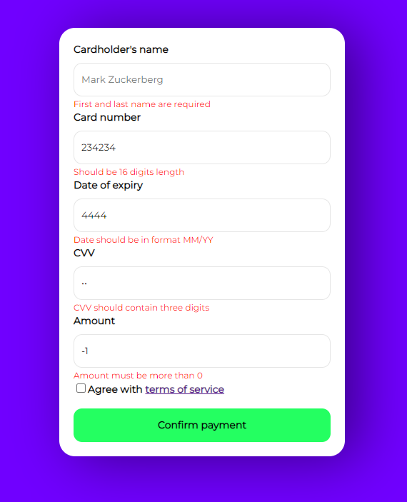
Errors:
“Field name” is required - for all fields
Card number
Should be 16 digits length
Date of expiry
Date should be in format MM/YY
CVV
CVV should contain three digits
Amount
Amount must be more than 0
Transactions more than 50000 are not allowed
Should the field block values greater than 16 digits?
Should the field block values greater than 3 digits?
© 2022 Комп'ютерна школа Hillel

Slide 12
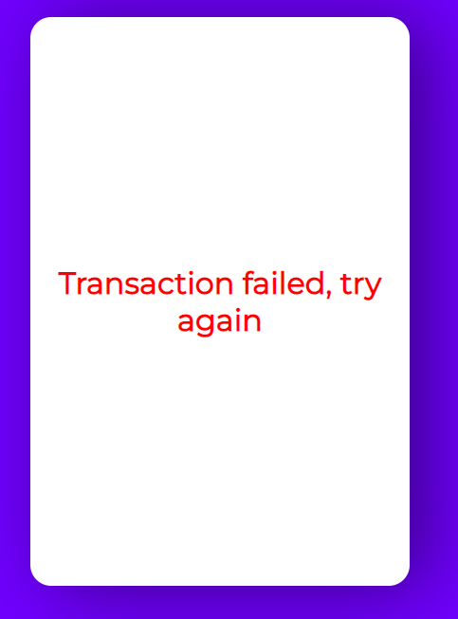
Transaction failed pop up
If some data not match with card data shows po up with text - Transaction failed, try again.
2222222 There is no description why does the transaction failed.
There is no button to close pop up/ How a user can close a pop up?
© 2022 Комп'ютерна школа Hillel

Slide 13

Додаток підтримує мобільну верстку. Нічого відмінного моб не буде мати від веб, з точки зору стайлу та функціоналу. Нижче наведено приклад як буде виглядати веб.

Slide 14
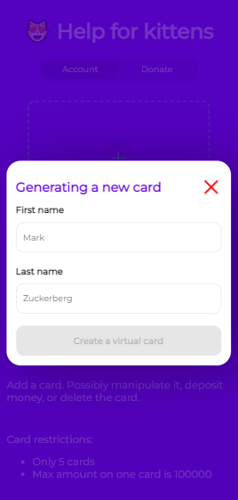
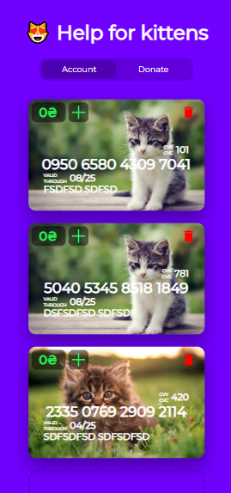
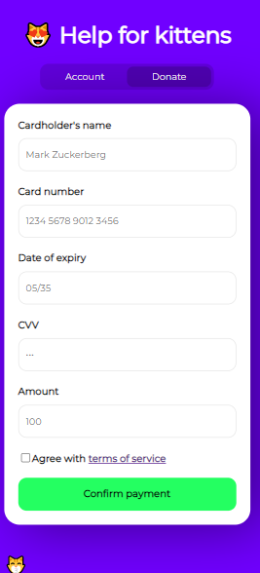
222222222 For which OS, devices and browsers should we test that application?
I think this button must to be enabled

